Slide 1

K.S. SCHOOL OF ENGINEERING AND MANAGEMENT DEPARTMENT OF ELECTRONICS AND COMMUNICATION ENGINEERING Mini Project Presentation on ‌ Real Time Responsive Automated Window and Water Supply Operator for Indoor Plantations using IOT
Project Team
Nithin Kumar N (1KG21EC059)
Punith P (1KG21EC066)
Rohith M J (1KG21EC073)
Tejas K (1KG21EC095)
Under the Guidance of
Prof. Bhargavi Rajendra Sangam

Slide 2
Introduction
‌The "Real Time Responsive Automated Window and Water Supply Operator for Indoor Plantations using IOT" is a project that aims to create a seamless and intuitive solution for controlling Windows as well as the rate of water dispense in real-time.
The project represents a pioneering effort in leveraging embedded technology to create a smart and responsive solution for enhancing convenience, and sustainability for growing sensitive and exotic plantations that need constant monitoring.
The System operates on a responsive basis, considering certain dynamically varying environmental parameters such as Temperature, Humidity and Light intensity in Real-Time.

Slide 3
Proposed Idea/Methodology
‌The objective of the project is to develop a sophisticated and responsive control system
Real-Time Responsiveness : The set up and the orientation change in accordance with atmosphere requirements parallel to time.
Embedded System Integration : The Plug in monitoring system based on IOT simplifies the process of basic nourishments and UV light treated water system.
Responsive Control Algorithms with User Interface :The aim is to deliver a state of solution for automated operation that enhances the algorithms that can be modified by the user for subjective plantations.

Slide 4
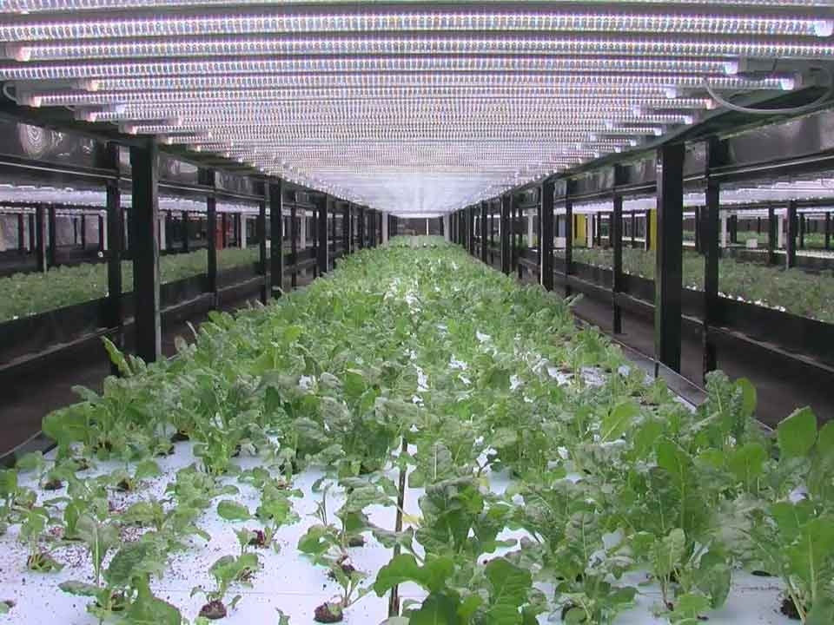
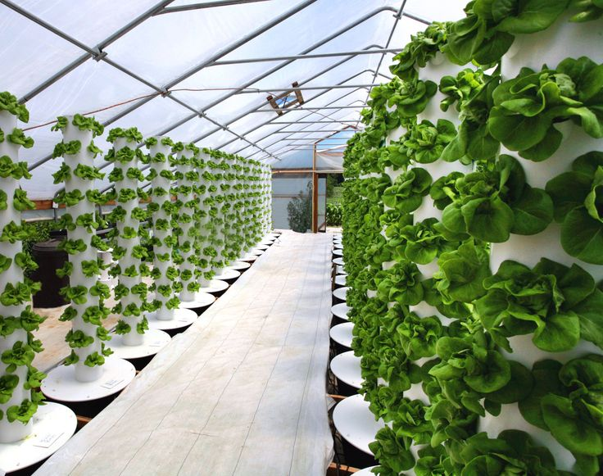
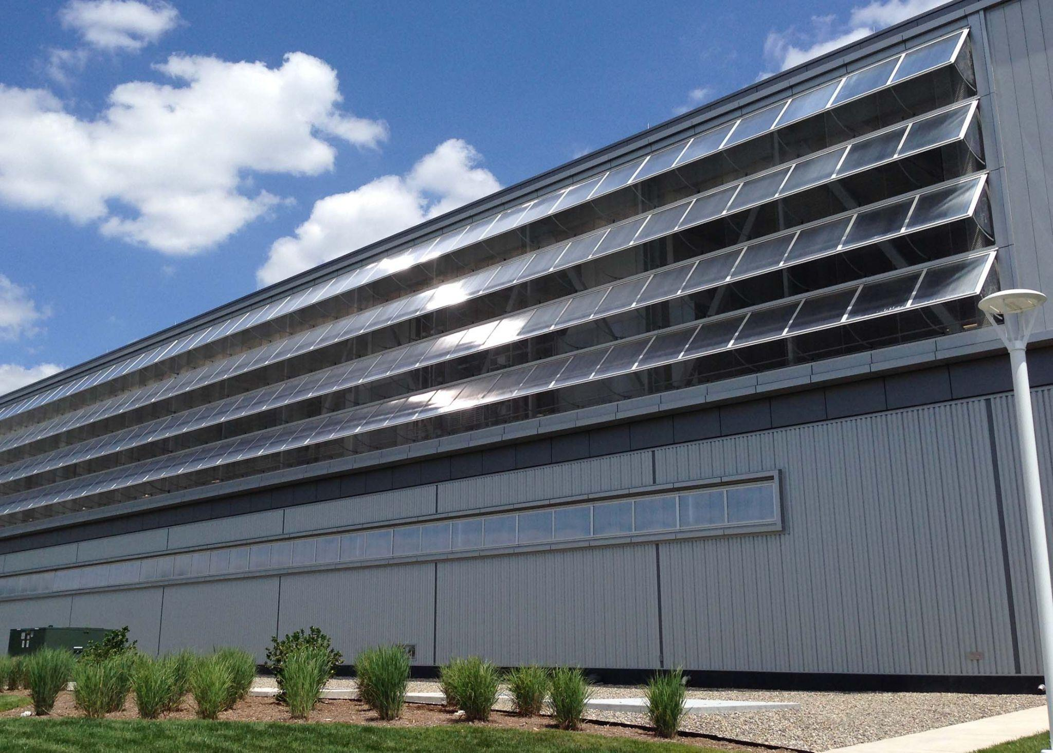
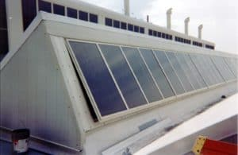
Areas of Implementations

Slide 5
Advantages , Applications, Limitations
Advantages:
Saves manual monitoring time.
Ensures atmospheric parameter's quality.
No extra labor cost required for the operation.
Safe protection from weather disruptions such as heavy rain, storms, strong winds etc.
Applications :
The project targets indoor farms and plantation nurseries .
Targeted specially on indoor plantation farms that are located in remote areas or in countries where water scarcity is serious factor.
This set-up of the project can be alternatively modified to captivate endangered species of animals such as rare apes, birds, fish that are breed in captivation of specific temperature habitats.
Limitations :
Cost of maintenance can be high cause of faulty components.
Normal gardener / Normal Zoo-keeper cannot operate the system without specific training/certified knowledge about IOT.
Margin for accuracy errors and risk factors of system fail is always to be considered.

Slide 6
References
[1] H. Shimizu, H. Matsumoto, M. Asakura and K. Watanabe, "A digital hygrometer," in IEEE Transactions on Instrumentation and Measurement, vol. 37, no. 2, pp. 300-304, June 1988, doi: 10.1109/19.6071.
[2] T. Islam, A. U. Khan, J. Akhtar and M. Z. U. Rahman, "A Digital Hygrometer for Trace Moisture Measurement," in IEEE Transactions on Industrial Electronics, vol. 61, no. 10, pp. 5599-5605, Oct. 2014, doi: 10.1109/TIE.2013.2297295.
[3] Divani, D., Patil, P., & Punjabi, S. K. (2016/04//). Automated plant watering system. The Institute of Electrical and Electronics Engineers, Inc.(IEEE) Conference Proceedings., , 180-182. Doi:https://doi.org/10.1109/ICCPEIC.2016.7557245.
[4] Roy, P., Saha, J., Dutta, N., & Chandra, S. (2018). Microcontroller based automated room light and fan controller. Piscataway: The Institute of Electrical and Electronics Engineers, Inc. (IEEE).
[5] UV water treatment. (2001/05/31/). Process Cooling & Equipment (Online),
[6] Silva, R. G., Szabo, J., Namboodiri, V., Krishnan, E. R., Rodriguez, J., & Zeigler, A. (2018/06//). Evaluation of an environmentally sustainable UV-assisted water treatment system for the removal of bacillus globigii spores in water. Water Science & Technology, 18(3), 968-975. doi:https://doi.org/10.2166/ws.2017.165

Slide 7
Thank You

